Slide 1
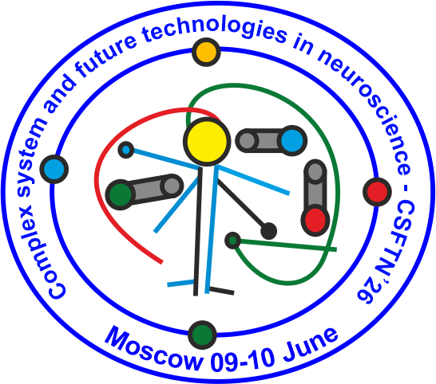

Photobiomodulation of brain waste removal system
Konstantsiia Sonina
Saratov State University
CSFTN’26
The research was supported by the Russian Science Foundation grant No. 23-75-30001
1

Slide 2

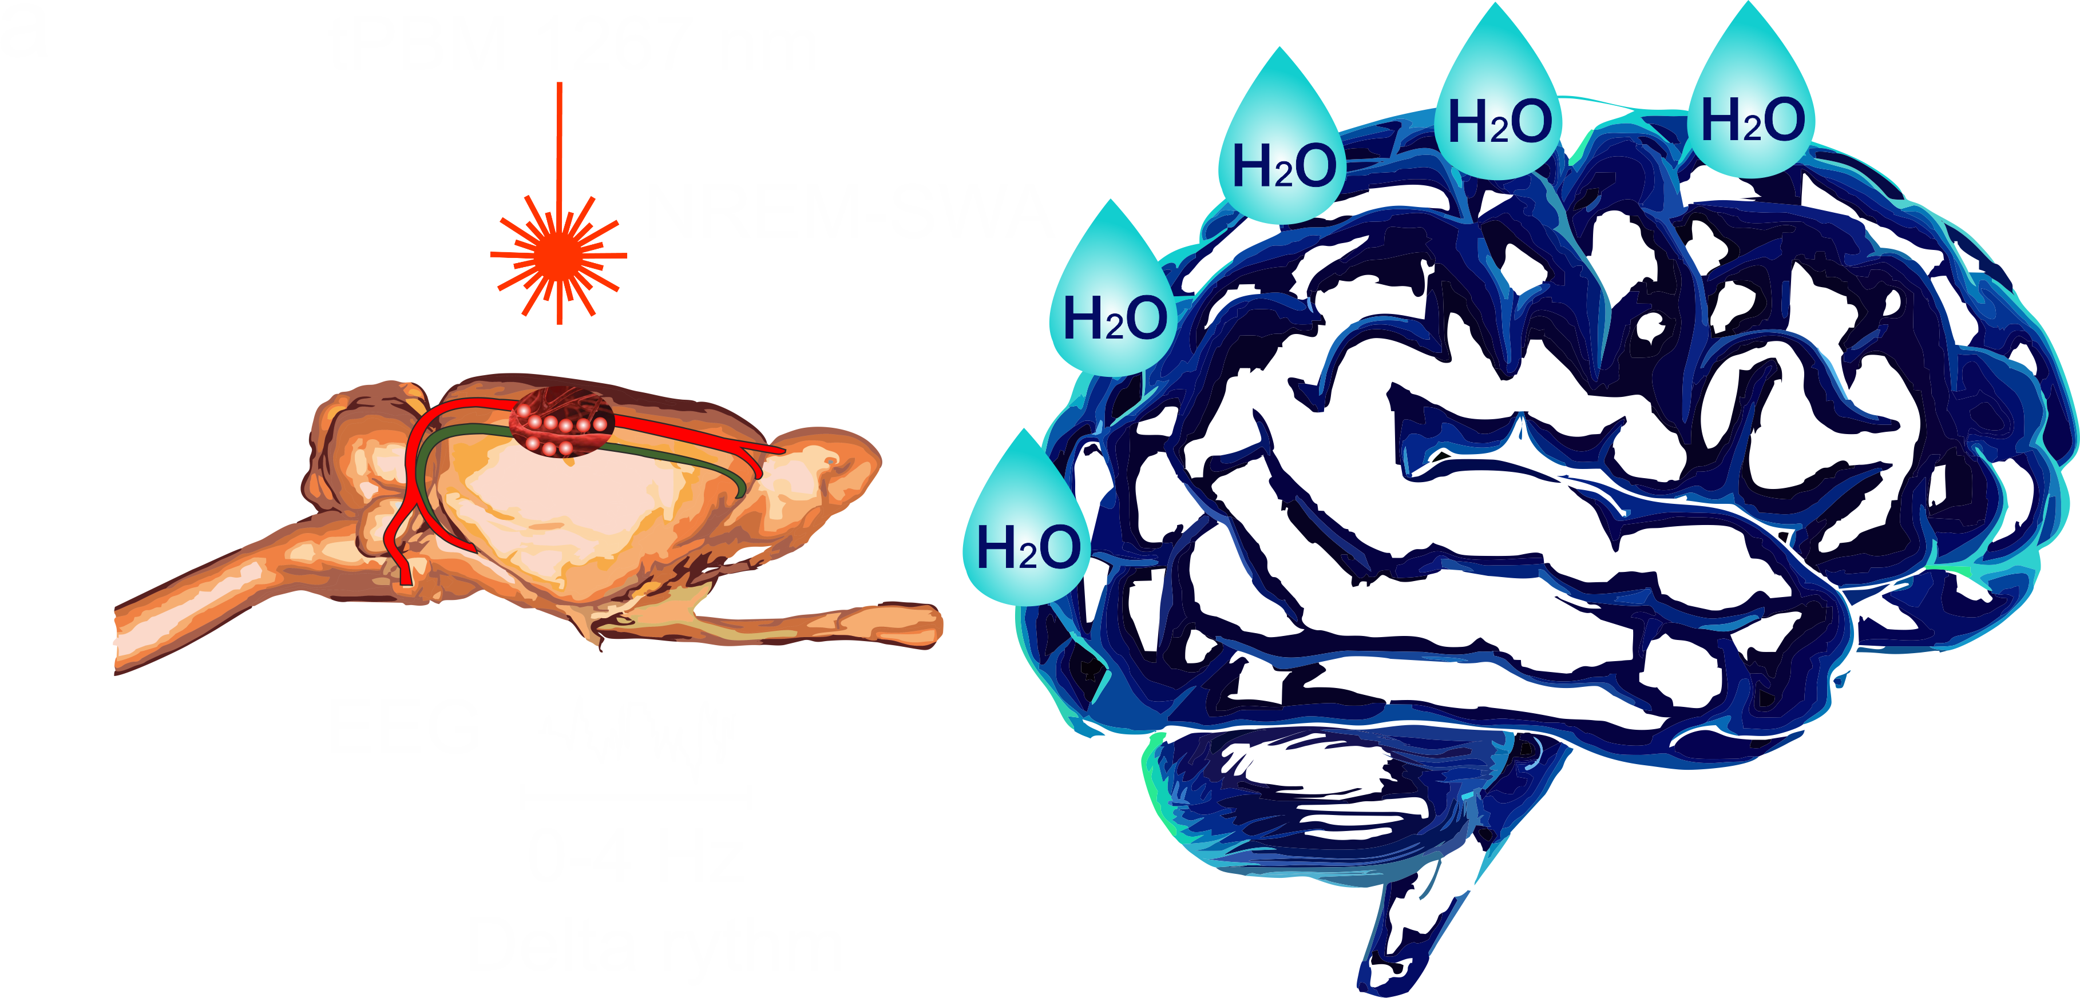
Since the BRWS is activated during deep sleep, tPBM-mediated stimulation of the clearance of wastes and toxins from the brain could be more effective if tPBM were used during the NREM-SWA activity of the sleeping brain than during wakefulness
CSFTN’26
The research was supported by the Russian Science Foundation grant No. 23-75-30001
2

Slide 3
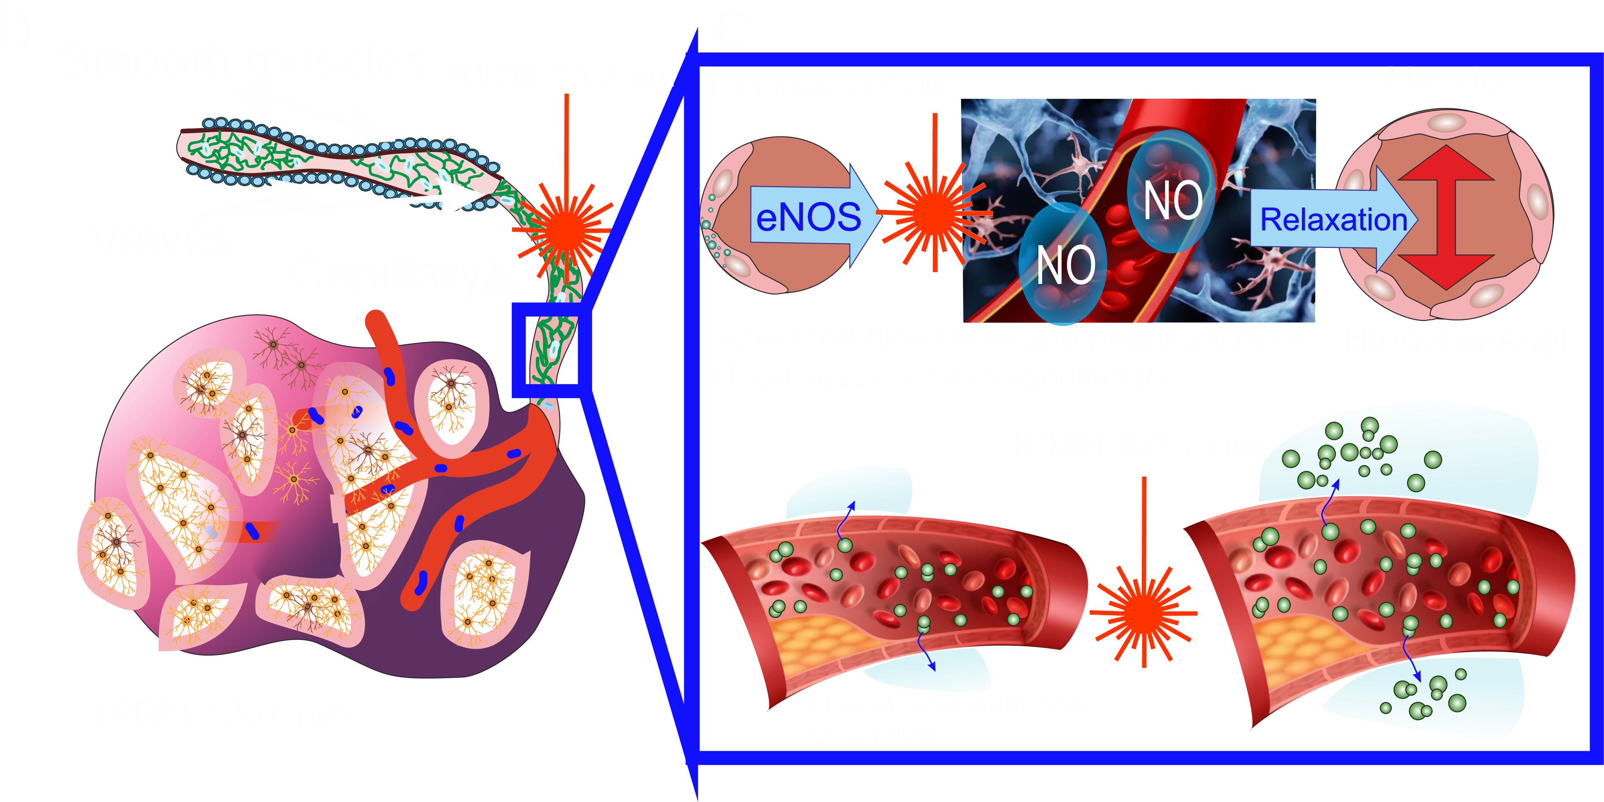
There is the hypothesis that tPBM modulates the tone and permeability of the lymphatic endothelium via the stimulation of eNOS and NO production, promoting the lymphatic clearance of wastes and toxins from brain tissues
CSFTN’26
The research was supported by the Russian Science Foundation grant No. 23-75-30001
3

Slide 4
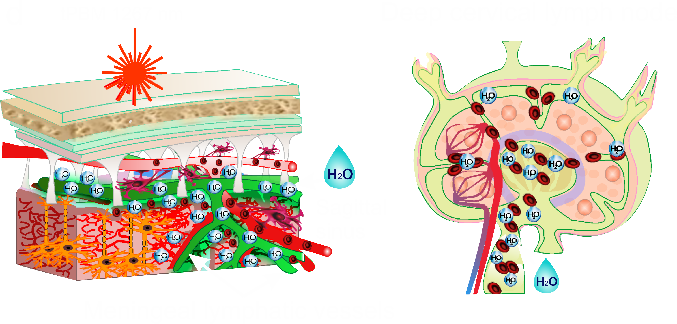
There is the hypothesis that tPBM modulates the tone and permeability of the lymphatic endothelium via the stimulation of eNOS and NO production, promoting the lymphatic clearance of wastes and toxins from brain tissues
CSFTN’26
The research was supported by the Russian Science Foundation grant No. 23-75-30001
4

